Slide 1
CV WRITING
Presented By: Kumar Kartikain Shivam

Slide 2

Activity – Design a poster (Elements to consider)
Design
Font and text styling
Visual characteristics
Background and overall
Informative
Formal requirements
Type of paper

Slide 3
ELEMENTS OF CV WRITING
PERSONAL DETAILS
ACADEMIC DETAILS
WORK EXPERIENCE DETAILS
PROJECT DETAILS
ACHIEVEMENTS
CO CURRICULAR DETAILS
EXTRA CURRICULAR DETAILS

Slide 4
PERSONAL DETAILS
NAME
FULL NAME (As per ID Proofs)
CONTACT INFORMATION
PHONE NUMBER (With Area Code)
EMAIL ID (Professional)
ADDRESS
ADDRESS (Hometown & State)

Slide 5
PHOTOGRAPH
Use only Professional Photograph.
Properly dressed in Professional Formal Attire. (Blazer, Tie, Light Coloured Shirt)
Plain White or Light coloured Background.
Carry a Fresh and Pleasant look with a Smile.

Slide 6
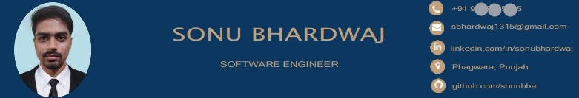
PROFILE – Resume Header

Slide 7
CV SUMMARY – Express yourself not your Skills
Do’s
Brief about Yourself
Your Perception for work
Your Style of Learning
Your Personality
Your Vision
Example: Computer Science enthusiast, eager to join a growth-oriented company and contribute to its success while learning from practical experience and developing professional skills.
Don’ts
No Grammatical Mistakes
No Overuse of Full-Stop
No Personal Pronouns
No Casual Vocabulary
No Long Paragraphs
No Technical Skills
Example: I am a young and professional guy who knows C++, Java, HTML and I have creative and innovative approach which will be helpful for any company. I am Looking for opportunities where I can learn programming skills to grow my career. I love Technology and want to do job in a stable company.

Slide 8
ACTIVITY 2
PRACTICE - CV SUMMARY
Frame 16 Qualities of yourself.
Ask at least 4 Friends/Colleagues to tell your 4 Qualities or Phrases about you.
See if it matches with Your 16 Qualities or not.
Figure Out your Vision for your Life/Job.
Now, cut incorporate these values in a brief Professional Summary.

Slide 9
TECHNICAL SKILLS
Align your Skills as per the Job Role.
Segregate your Skills as per the Category.
Highlight the Headings in BOLD.
Make sure the Skills you have Mentioned have been used in the Projects & Internships you have done.

Slide 10
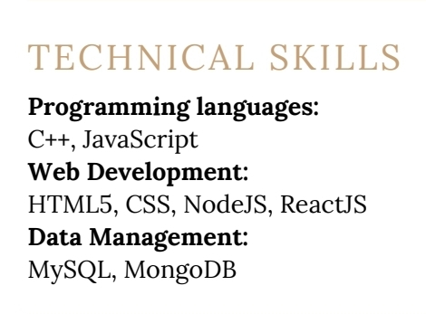
TECHNICAL SKILLS

Slide 11
POWER SKILLS
Be Ready for Justification with Examples from Real Life or Work/Internships etc.
Write the Power Skills as received in the PAT Result.
Align your Power Skills also as per the Job Role.
Refer to the Excel sheet for phrases alignment.
Mention Power Skills in Phrases not words.
Highlight the Heading in BOLD.

Slide 12
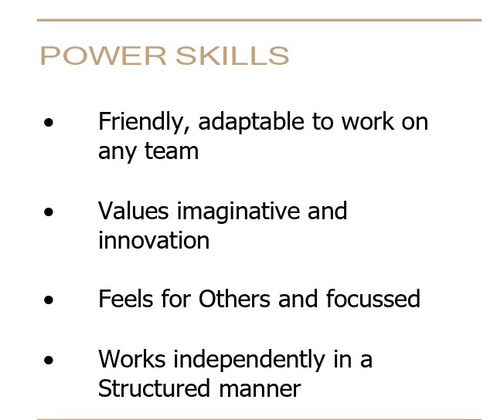
POWER SKILLS

Slide 13
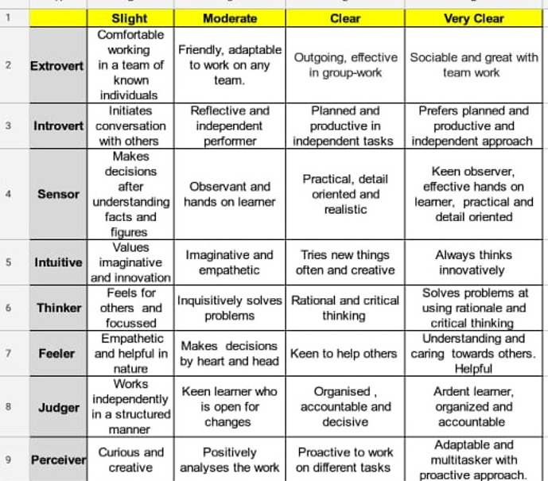
POWER SKILLS ALIGNMENT SHEET

Slide 14
ACADEMIC DETAILS
DEGREE/COURSE NAME – Most Recent at Top
YEAR OF PASSING – In Reverse Chronology
CGPA/PERCENTAGE – Mention if Above 7 or 7
UNIVERSITY/COLLEGE NAME – No Short-form
BOARD OF EDUCATION – Can be in Short-form

Slide 15
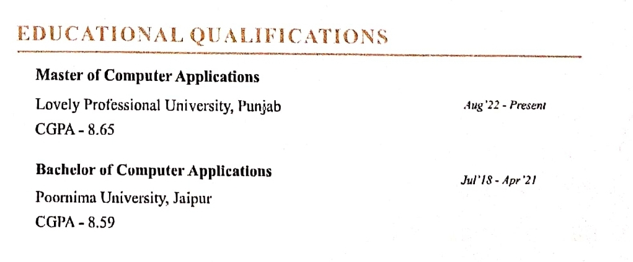
ACADEMIC DETAILS

Slide 16
Let’s practice...
Mention your Education History in the last section of the right side of your Resume.
Follow Reverse Chronology – Most recent at Top followed by Previous.
At least 3 Degrees/Studies you can mention.
Timeline is very Important to be mentioned along with the Degree. (Month & Year)
Mention CGPA & Percentage if 7 or 7+/75% or Above.

Slide 17
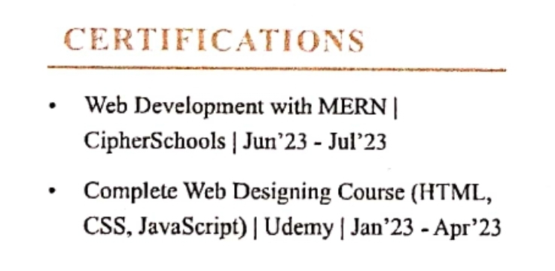
CERTIFICATIONS – Verified Certificate Earned

Slide 18
Let’s practice...
Mention the most Valued Certifications (If done many). Or
Mention the ones which relates to the Job applied for.
Name of the Certification, Certifying Authority & Timeline is very important to be mentioned.
If you still have nothing to write in CERTIFICATIONS then the chances of your CV getting shortlisted starts to decrease.
So start to doing CERTIFICATIONS time-to-time as per your INTEREST and the INDUSTRY DEMAND to STAND OUT.

Slide 19
WORK EXPERIENCE TYPES
PAID WORK EXPERIENCE
FULL TIME JOB
PART TIME JOB
INTERNSHIP WITH STIPEND
UNPAID WORK EXPERIENCE
INTERNSHIP WITHOUT STIPEND
APPRENTICESHIP

Slide 20
WORK EXPERIENCE DETAILS
INSTITUTION’s NAME – As Per the Brand
DURATION OF WORK – Years/Months
DESIGNATION – Job Role
WORK PROFILE – Duties/Responsibilities
ACHIEVEMENTS – Distinction Received

Slide 21
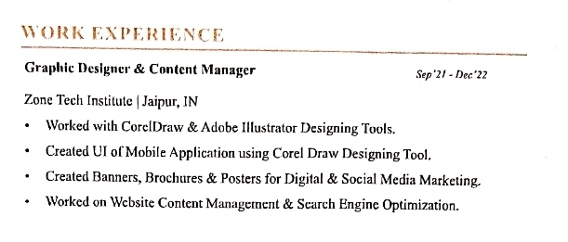
WORK EXPERIENCE

Slide 22
WORK EXPERIENCE – Industry Expertise
Starting with the Most recent one go to the previous Experiences.
Mention Experiences which you can Justify by some Documentation or Proof i.e.:
Salary Slips – Shows your Payroll with the Company.
Experience Letter – Shows your Conduct and Relation with Company.
Relieving Letter – Shows that are free from all your Association with previous Company.
No Objection Certificate (NOC) – Show that you have no legal disputes with the previous Company.

Slide 23
PROJECTS – Presents your Practical Competency
Live Projects: Real-world assignments or tasks undertaken by students to gain practical experience while studying.
Dissertation: An extended research project, often required for an academic degree, involving in-depth study and independent analysis.
Thesis: A substantial document presenting original research, findings, and arguments, typically required for postgraduate or doctoral degrees.
Major Projects: Comprehensive academic undertakings, usually a culmination of a program, that demand substantial research, planning, and execution.
Minor Projects: Smaller-scale academic tasks or assignments designed to develop specific skills or knowledge.
Research Projects: Investigations conducted to address specific questions or problems, aimed at contributing new insights or solutions to a field of study.

Slide 24
PROJECTS – To show Consistent Learning
NAME OF THE PROJECT – In BOLD Letters
DURATION – Month/Year in front of the Name (Extreme Right)
COMPANY/PLACE – Next to Name of Project
Write the Following in Past Tense only:
PROJECT DESCRIPTION – Brief about the Project (Why, How, What, When)
ACHIEVEMENTS – Learning Outcome (What did you Learn in the End of the Project)

Slide 25
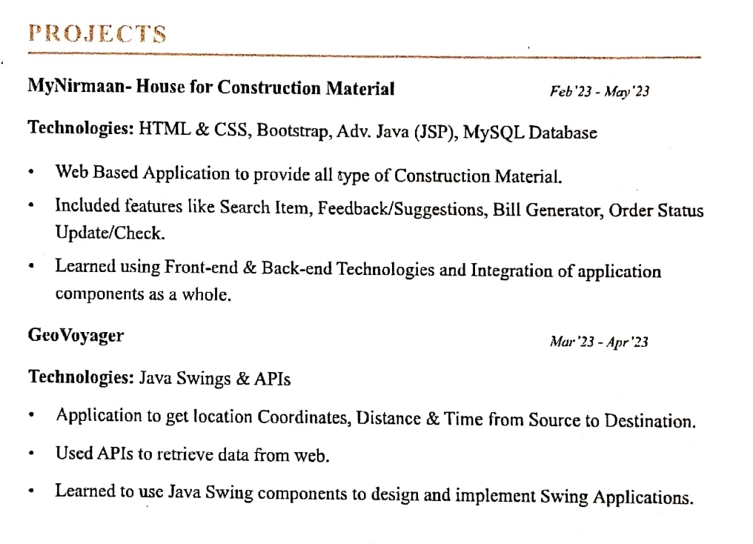
PROJECTS – Very Important for FRESHERS

Slide 26
CO CURRICULAR DETAILS – Presents Soft Skills
GUEST LECTURE/SEMINARS, WORKSHOPS, HACKATHONS
RESOURCE PERSON
TOPIC
COMPANY NAME
COMPETITIONS, CERTIFICATIONS & CERTIFICATES
NAME OF CERTIFICATION
NAME OF CERTIFYING AGENCY/COMPANY
DATE OF ISSUE

Slide 27
CO CURRICULAR DETAILS – Shows Activeness
By engaging in co-curricular activities, students can acquire:
Leadership, Communication and Management Skills.
Improve their Problem Solving Ability, Gain knowledge in various fields.
Develop Vocational Skills & Learn to work as Part of a Team.
These skills transfer well to SUCCESS at a Job and in a Career as these build character and instill important values like: Compassion & Empathy. (Top Priority of MNCs)
Participation in Co-Curricular Activities DOUBLES your Chances to get HIRED for the Job.

Slide 28
CO CURRICULAR DETAILS – Your Competency
Mention carefully by aligning it with the Job Requirements.
It will HIGHLIGHT your Strengths & Professionalism.
Shows your Calibre in allied areas with your Field.
Represent your Pro-Activeness.
GLOBAL COMPANIES gives weightage to Candidates with STRONG Co-Curricular background, as it confirms that the Candidate can Multitask by Managing Time and is Adaptable to changing scenarios to ACHIEVE more and more.

Slide 29
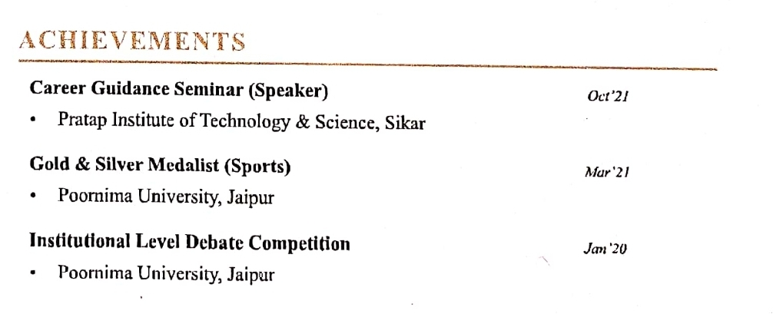
CO CURRICULAR DETAILS – The Best FIT

Slide 30
EXTRA CURRICULAR DETAILS
POSITIONS OF RESPONSIBILITY
DESIGNATION
NAME OF ORGANISATION/CLUB/EVENT
DATE/DURATION
PARTICIPATIONS
NAME OF THE EVENT
PLACE/UNIVERSITY/COLLEGE/ORGANISER’S NAME
DATE OF THE EVENT

Slide 31
EXTRA CURRICULAR DETAILS - Dominator
Extra-curricular activities are a valuable investment in your future.
Research showing that students who participate in activities outside of their studies tend to have higher grades, better exam scores, and more positive educational experiences in general which INTESIFIES their Chances to have a REWARDING CAREER & SUCCESS in PROFESSIONAL LIFE.
So HURRY UP!!! & Enroll in CLUBS, Take part in & Organize EVENTS and WORKSHOPS to DOMINATE the WORLD.

Slide 32
EXTRA CURRICULAR DETAILS – To RULE
ACHIEVEMENTS in:
CLUBS, EVENT, SPORTS, COMPETITIONS
POSITION/AWARD NAME
NAME OF THE CLUB/EVENT
PLACE/UNIVERSITY/COLLEGE/ORGANISER’S NAME
DATE OF THE EVENT
Such Participations makes you the LEADER among others as you come out as More OUTGOING & SKILLFUL candidate and EMPLOYERS Yearns for such TALENT.

Slide 33
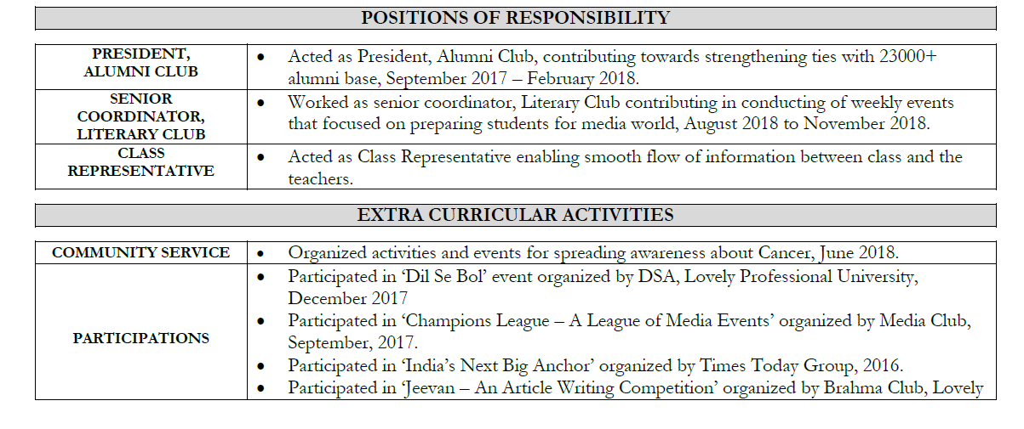
EXTRA CURRICULAR DETAILS – The PREDATOR

Slide 34
EXTRA CURRICULAR DETAILS – Where are YOU?
Jot down the List of Club Activities, Positions you are holding.
Make these Clubs/Events known by your NAME & TALENT.
Influence others to Join & Collaborate with you.
Build your Community STRONGER & LARGER.
BUILD your BRAND.
Earn Certificates & Awards of Recognition to Make Yourself ‘THE TALK OF THE TOWN’
Give EMPLOYERS all the REASONS to HIRE YOU!!!

Slide 35
CV MAKING - What you need to do….
PROBE REGARDING YOUR ACTIVITIES
UNDERSTAND THE USAGE OF ACTION VERBS
EXAMPLES OF ACTION VERBS
DESIGNED/CREATED/ANALYSED/LEARNT/UNDERSTOOD/WORKED/HELPED/GUIDED/WROTE
ATTENDED/COMPLETED/RECEIVED/PARTICIPATED IN /ACHIEVED/COORDINATED
ASSIGNED/PERFORMED/SELECTED AS/SELECTED IN

Slide 36
PARAMETERS OF ASSESSMENT
Format as per model CV (all elements mentioned in correct order)
Grammar and spellings
Content (including a detailed description of projects and internships)
Extracurricular participation. (VERY IMPORTANT)

Slide 37
Common Mistakes in CV Writing
Do not use informal Email ID’s.
Do not put Mr. Or Ms. Before your name.
Be careful of the Grammar and Vocabulary.
Avoid difficult jargons or frivolous acronyms.
Adhere to the format and the fonts of format.
Strange or controversial hobbies and/or extra curricular achievements should be avoided.

Slide 38
Common Mistakes in CV Writing (Continued)
Stick to the basic language.
Do not convert the file to PDF.
Every point in the CV starts with an actionable verb and is a phrase.
The length of the CV should not exceed one page without a good reason.
DO NOT WRITE SOMETHING IN YOUR CV THAT YOU ARE NOT AWARE OF OR CAN NOT EXPLAIN/JUSTIFY.

Slide 39

A common Doubt….. Where do I get the data from??

Slide 40
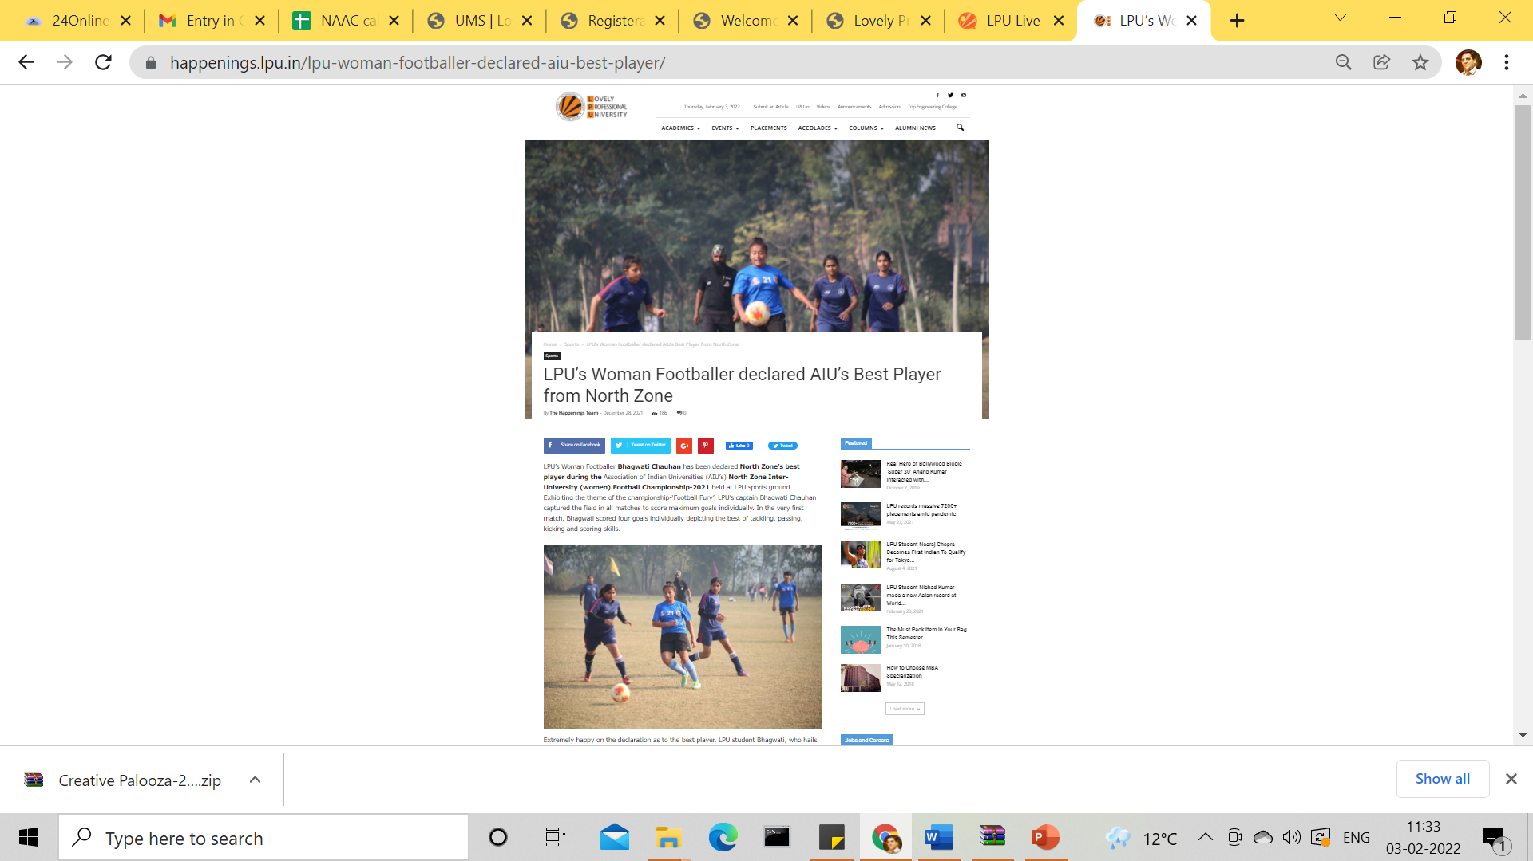
https://happenings.lpu.in/

Slide 41
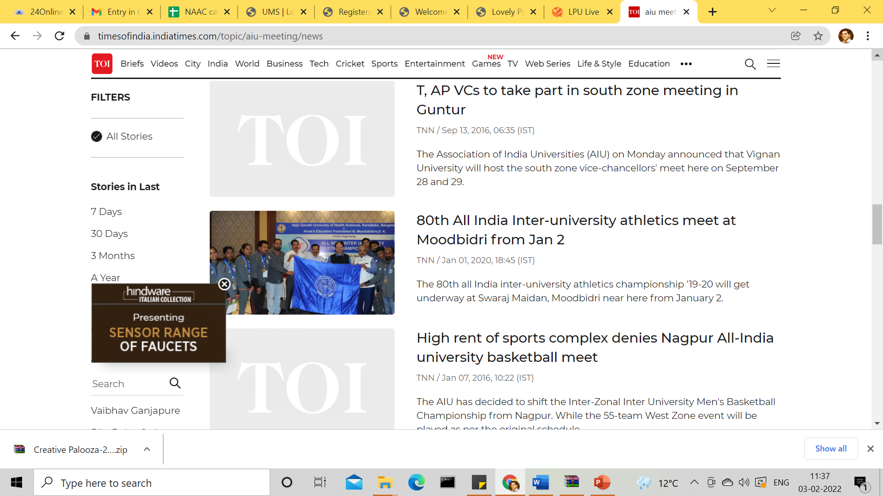
On Google

Slide 42

Ask Teachers, Friends or Event Coordinators

Slide 43

Own your Certificates

Slide 44
HOW YOUR CV SHOULD LOOK LIKE
CORRECT FORMAT
IMPRESSIVE ACHIEVEMENTS
PROFESSIONAL VOCABULARY
RIGHT AMOUNT OF KEYWORDS
REQUIRED SKILLS & QUALIFICATIONS
ALL THE SECTIONS ALIGNED & JUSTIFIED

Slide 45


